Slide 1
Event tickets built on the blockchain
BloxOffice

Slide 2


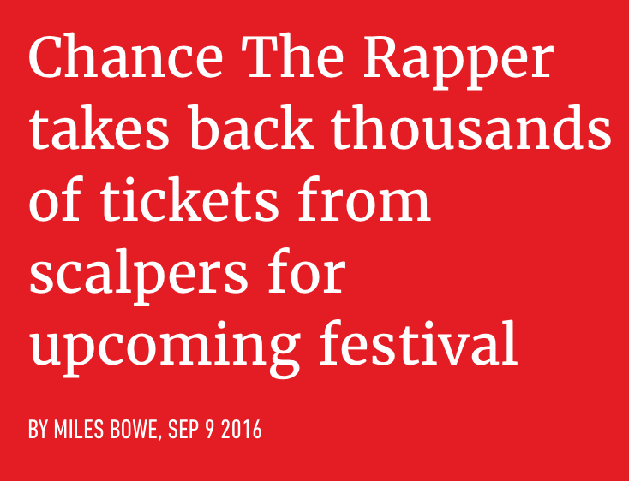
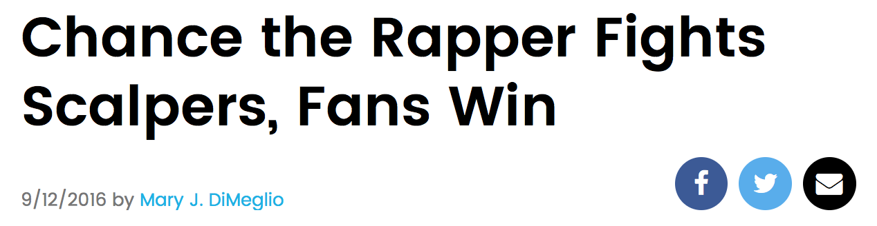
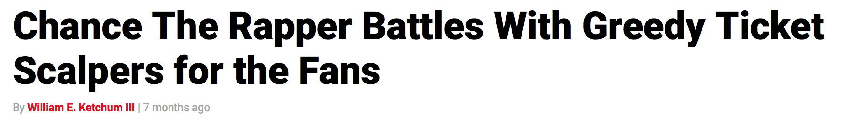

Slide 3
What’s the Problem?
Scalping
Fake tickets
Bots
Ticket hoarding
Resale price gouging

Slide 4



Hack Western Development
36 Hours Later
Developed 2 Smart Contracts
Deployed On DF’s Ethereum Network
Connected ABI’s to HTML Front
Next Steps: Front End UI

Slide 5



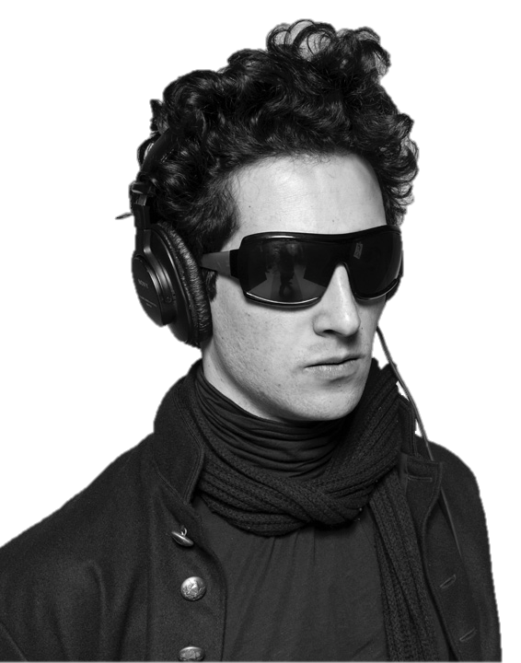
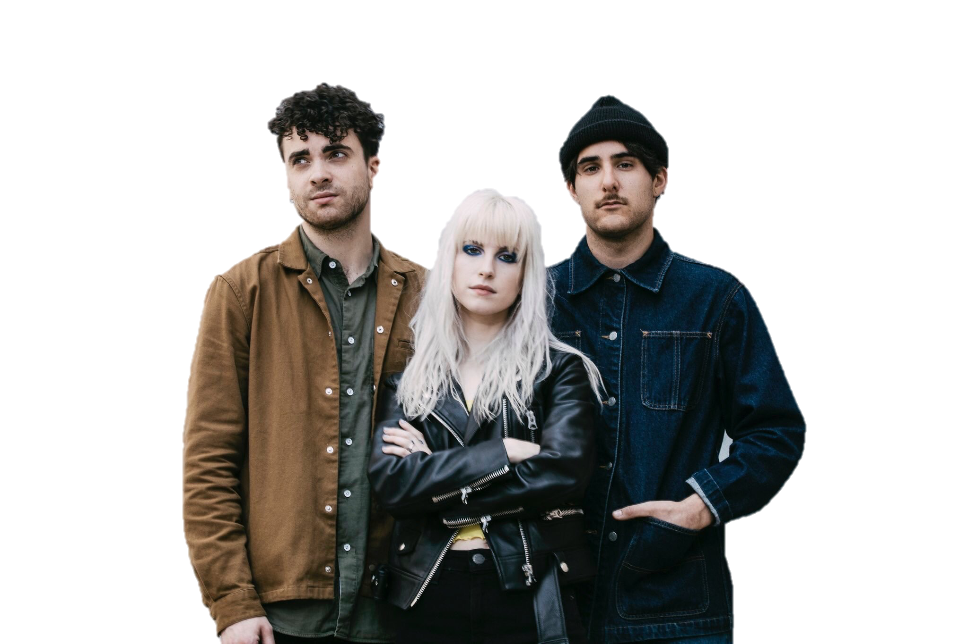



BloxOffice
Search
What’s Hot
Music
Sports
Arts & Theatre
Toronto, ON
January 2017
Music
Filters:
Jessie Reyez
Toronto
January 2
Francis &
the Lights
Toronto
January 6
Chance the
Rapper
Toronto
January 11
Paramore
Toronto
January 15
Daniel Caesar
Toronto
January 29
Gus Dapperton
Toronto
January 31

Slide 6

◁
Tickets: Toronto, Ca…
Mobile User
Interface
Jessie Reyez
Toronto
January 2
Chance the
Rapper
Toronto
January 11
Daniel Caesar
Toronto
January 29

Slide 7

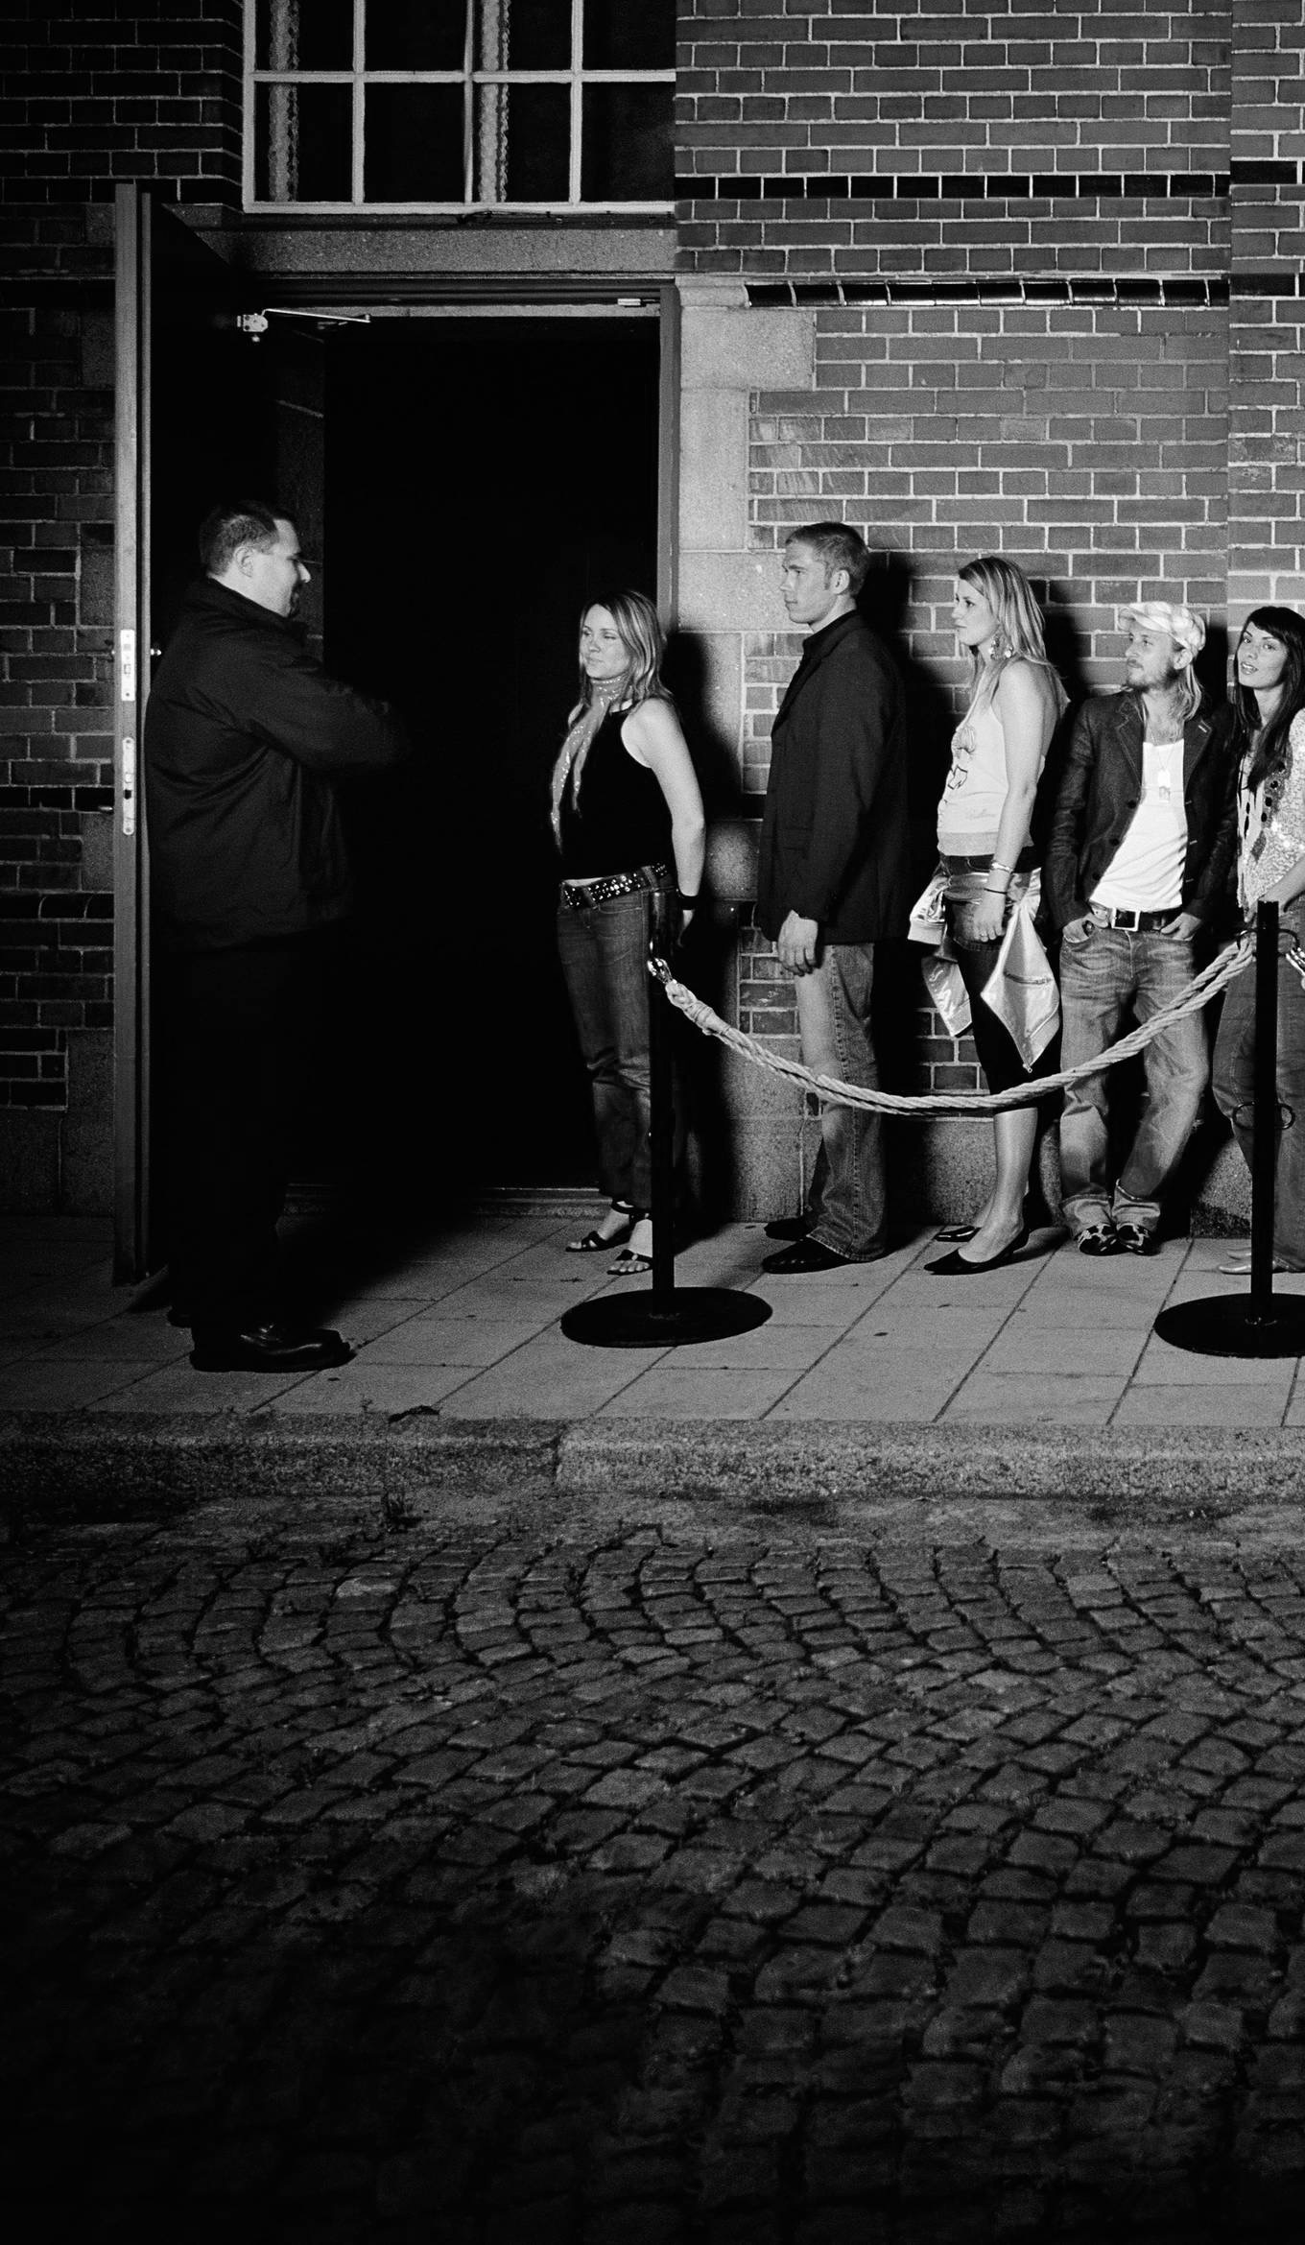

1) In-App Purchase
2) Scan
3) Party

Slide 8

The Opportunity
Revenue
3% ticket value (including resale)
Projection: over $250,000.00 by 2020
12 customers
600 tickets/customer/week
$25/ticket

Slide 9
Questions?

Slide 10
Next 12 Months
Web hosting, domain, web server, database server
$900
Branding, media, marketing materials
$1000
Miscellaneous (e.g. incorporation)
$400

Slide 11
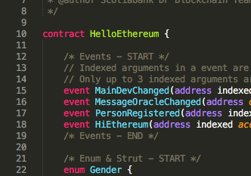

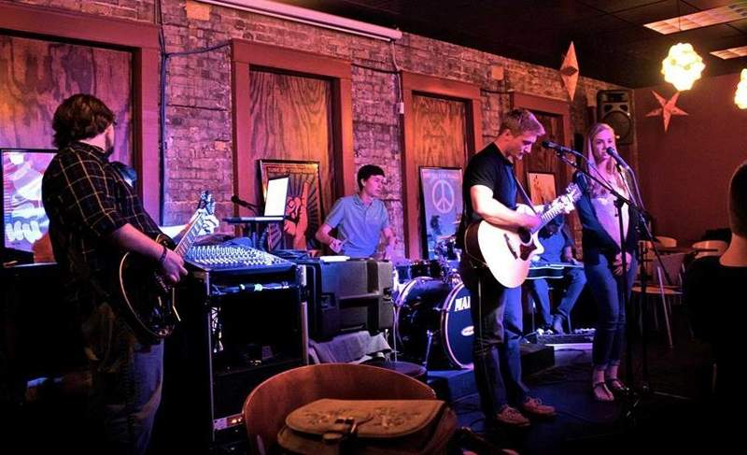
Hack Western Development
Western University
London Music Hall
London Music Club

Slide 12
The BloxOffice Solution
BloxOffice is a mobile app
Immutable ticket history
Regulated resale platform
A tool, not a service
Unique purchase identity

Slide 13
The Current Solution
“Hello, can I have my money back? Adele fan loses a whopping $3,000 to ticket scalpers” – Daily Mail (March 28, 2017)
“Ontario is trying to crack down on robotic ticket scalpers but no one expects an easy fix” – London Free Press (March 1, 2017)
“Ticket-scalping bots set to face unlimited fines” – CNBC (March 13, 2017)
“Manitoba concert industry looks for big changes to combat ticket scalping” – CBC News (March 8, 2017)
“Ontario government to consult fans about event ticket selling, buying” – CBC News (February 28, 2017)
No resale
Credit-card ticket
Ticket limits
Legislation
CAPTCHA
And more…

